Slide 1

City of Mineola
Second Quarter, FY 2018-2019
Financial Reports
Notes:
Water Sales are 63% of revenue

Slide 2
General Fund Revenue
2nd Quarter, FY 2019

Slide 3
General Fund Revenue
YTD Budget $2,731,281.00
YTD Actual $3,135,683.87
Variance (+/-) $ 404,402.87

Slide 4
Sales Tax
Sales Tax up 6.70% over Last Year
Budgeted 3% increase over Last Year
YTD Actual $1,066,121.19
YTD Budget $1,041,439.00
Variance (+/-) + $24,682.19

Slide 5
Refuse Collection

Slide 6
Hotel Motel Tax
HOT Funds down only 7% over this period Last Year
YTD Prior Year $37,033.06
YTD Actual $34,549.11
YTD Budget $35,000.00
Variance (+/-) -$450.89

Slide 7
General Fund Expenditures
Total General Fund Expenditures at 46.19% of budget
Total Excess Revenue over Expenditures $599,716.97

Slide 8
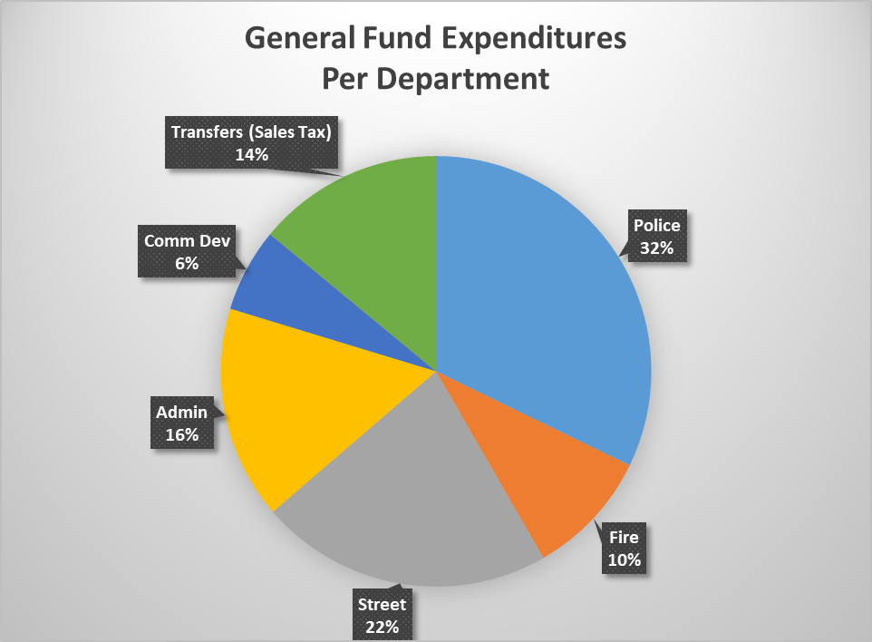
General Fund Expenditures
(Second Quarter FY 19)
YTD Budget $2,745,419.00
YTD Actual $2,535,966.90
Variance (+/-) $ 209,452.10

Slide 9
General Fund Revenue & Expense (3yr)
FY 2016-2017 Revenues exceeded Expenditures by $102,500.00
FY 2017-2018 Revenues exceed Expenditures by $274,537.80
YTD 2018-2019 Revenues exceed Expenditures by $622,956.47
Notes:
For the reporting period, expenses exceed revenues by $313,136.25

Slide 10
General Fund Balance
Cash Account balances as of March for last five years
Only considering Operating Funds and Investment Account
Notes:
$

Slide 11
Water Fund Revenue
Water Sales are at 40.92% of budget.
Sewer Sales are at 46.26%
Total Revenue for Water Fund 44.95%

Slide 12
Water Fund Revenue
YTD Budget $1,313,678.00
YTD Actual $1,180,883.60
Variance (+/-) $ -132,794.40

Slide 13
Water Fund Expenditures
Total Water Fund Expenditures at 40.90% of budget
Total Excess Revenue Over Expenditures $106,274.70

Slide 14
Water Fund Expenditures
(2nd Quarter FY 19)
YTD Budget $1,313,677.00
YTD Actual $1,074,608.90
Variance (+/-) $239,068.10

Slide 15
Water Fund Revenue & Expense (3yr)
FY 2016-2017 Revenues exceeded Expenditures by $189,637.18
FY 2017-2018 Revenues exceed Expenditures by $459,159.77
YTD 2018-2019 Revenues exceeded Expenditures by $106,274.70

Slide 16
Water Fund Balance
Cash Account balances as of March for last five years
Notes:
$

Slide 17
Cash Balances
Total City Funds, including bond funds
Better investing resulting in higher yield

Slide 18
Interest Rates
The US Treasury Yield Curve continues to rise
City funds are invested in Money Market accounts which earn .4% over the US Treasury Yield Curve as reflected on the last day of the month.
Rates at bank continue to out-perform both the TexPool and TexPool Prime rates.

Slide 19
Total Debt Service
Total Outstanding Debt as of FY 2018-2019 $21,987,502.00
Water & Sewer $13,652,305
Sales Tax (MEDC) $ 4,819,463
I&S (Property Tax) $ 3,515,734
Final Payment 2037

